Slide 1
Introduction to Node.js

Slide 2
What is Node.js
In a simple word, it is server-side JavaScript.
Before node.js execution environment was limited to browser only. Now we can execute from command prompt also. So, it is a command-line tool
High performance network applications framework, well-optimized for high concurrent environments.
It is written in both JavaScript and C++.

Slide 3
What is Node.js?
Node.js uses event-driven, non-blocking I/O model, which makes it light weight
It makes use of event-driven loops via JavScript callback functionality to implment the non-blocking I/O.
Programs for node js written in JavaScript but not in same JavaScript we are use to. There is not Dom implementation provided by Node, i.e we cannot do this:
Var elem=document.getElementById(“name”)
Every thing in node js is a single thread.

Slide 4
What Can Node.js Do?
Node.js can generate dynamic page content
Node.js can create, open, read, write, delete, and close files on the server
Node.js can collect form data
Node.js can add, delete, modify data in your database
We can create HTTP server
We can create TCP Server
We can create DNS server
We can create Static File Server

Slide 5
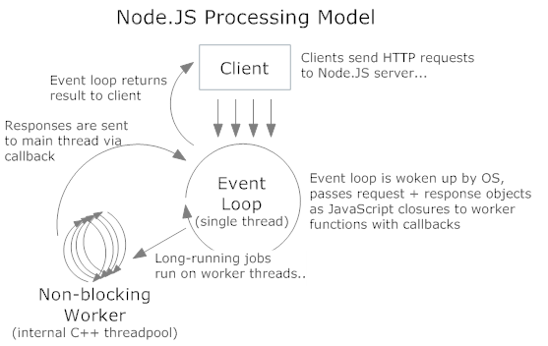
What is Even-loop in JavaScript?
Even-loop is the core of event-driven programming.
Almost all the UI programs use event-loops to track the user event

Slide 6
Node.js Ecosystem
Nod.js heavily relies on modules. We can import any module with “require” keyword
Creating module is very easy. We keep everything inside javascript file and call the file with require keyword
Libraries, named as packages can be installed easily with the help of “npm” tool
Npm install <library_name>

Slide 7
The Read-Eval-Print-Loop(REPL)
an interactive shell provided by node.
reads input from the user, evaluates the input as JavaScript code, prints the result, and then waits for more input.
Example:
$ node
> var foo = "Hello World!";
undefined
> foo;
'Hello World!'
> console.log(foo);
Hello World!
Undefined

Slide 8
The Read-Eval-Print-Loop(REPL)
.help
The .help command displays all of the available REPL commands. Listing 1 shows the output of running the .help command.
Listing 1. Output of the .help REPL Command
> .help
.break Sometimes you get stuck, this gets you out
.clear Alias for .break
.exit Exit the repl
.help Show repl options
.load Load JS from a file into the REPL session

Slide 9
The Read-Eval-Print-Loop(REPL)
.exit
The .exit command terminates the REPL. This command is equivalent to pressing Control+D.
.break
The .break command, used to bail out of a multiline expression, is useful if you make a mistake or simply choose
not to complete the expression. Listing 2 shows an example of using the .break command to terminate a for loop
prior to completion. Notice that the normal > prompt is shown after the .break command.
Listing 2. Terminating a Multiline Expression Using the .break Command
> for (var i = 0; i < 10; i++) {
... .break
>

Slide 10
The Read-Eval-Print-Loop(REPL)
.save filename
The .save command saves the current REPL session to the file specified in filename. If the file does not exist, it is created. If the file does exist, the existing file is overwritten. REPL commands and output are not saved. Listing 4-13 shows an example use of the .save command. In this example, the current session is saved to the file repl-test.js. The resulting contents of repl-test.js are shown in Listing 4-14. Notice that the file does not contain the REPL prompt or output or the .save command.
Listing 3. Saving the Current REPL Session Using the .save Command
> var foo = [1, 2, 3];
undefined
> foo.forEach(function(value) {
... console.log(value);
... });
1
2
3
undefined
> .save repl-test.js
Session saved to:repl-test.js
Listing 4-14. The Contents of repl-test.js Generated by the .save Command
var foo = [1, 2, 3];
foo.forEach(function(value) {
console.log(value);
});

Slide 11
.load filename
The .load command executes the JavaScript file specified in filename. The file is executed as if each line were typed
directly into the REPL. Listing 4 shows the output of loading the file repl-test.js from Listing 4.
Listing 4. The result of executing repl-test.js, using the .load command
> .load repl-test.js
> var foo = [1, 2, 3];
undefined
> foo.forEach(function(value) {
... console.log(value);
... });
1
2
3
Undefined
.clear
Similar to .break, .clear can be used to terminate multiline expressions. .clear is also used to reset the REPL’s context object. At this point, you don’t need to understand the details, but Listing 5 shows a Node program that embeds a REPL. In other words, running this program actually invokes an instance of the REPL. Additionally, you can define a custom execution environment for the REPL. In this case, the embedded REPL has a defined variable, foo, that holds the string "Hello REPL". Calling .clear from within the embedded REPL resets the context and deletes foo.
Listing 5. Embedding a REPL Within Another Node Program
var repl = require("repl");
repl.start({}).context.foo = "Hello REPL";

Slide 12
The Node Module System
Managing Modules involves:
Installing Packages
Retrieving Package Location
Global packages
Linking and unlinking packages
Updating packages
Uninstalling Packages

Slide 13
The Node Module System
installing Packages:
Syntax:
npm install module-name options
Options are g(global), i(interactive)
Example:
npm install express -g

Slide 14
The Node Module System
Package Locations
When packages are installed, they are saved somewhere on your local machine. Typically, this location is a subdirectory named node_modules within your current directory. To determine the location, use the command “npm root”.
Global Packages
Packages, as described thus far, are libraries that are included in your program. Referred to as local packages, these must
be installed in every project using them. Another type of package, known as a global package, needs to be installed
in only one location. Although global packages typically do not include code libraries, they can. As a rule of thumb,
global packages normally contain command line tools, which should be included in the PATH environment variable

Slide 15
The Node Module System
Linking Packages and Unlinking Packages
Using npm, you can create links to local packages. When you link to a package, it can be referenced as if it were a global package. This is especially useful if you are developing a module and want another project to reference your local copy of the module. Linking is also useful if you want to deploy your module without publishing it to the public npm registry..
The process for removing linked modules is very similar to the process for creating them. To remove a linked module from an application, use the npm unlink command, followed by the name.
Updating Packages
Since any package that is actively developed eventually releases a new version, your copy will become outdated. To determine if your copy is out of date, run npm outdated in your project directory
To update any outdated local packages, use the npm update command. Much like outdated, update works on all local packages by default. Again, you can target individual modules by specifying their names. You can also update global packages using the -g option. In Listing 6, npm updates itself using the -g option.
Listing 6. Updating npm Using npm update
$ npm update npm –g

Slide 16
The Node Module System
Uninstalling Packages
To remove a package, use either the npm uninstall or npm rm command (the two commands can be used interchangeably), and specify one or more packages to be removed. You can also remove global packages by providing the -g option. Listing 4-23 shows how to remove the commander module using npm rm.
Listing 7. Uninstalling commander Using npm rm
$ npm rm commander

Slide 17
The Node Module System
The require() Function
Node packages are managed using nmp, but it is important to import that package .
The require function import packages for us.
require() accepts a single argument, a string specifying the module to load.
If the specified module path exists, require() returns an object that can be used to interface with the module.
If the module cannot be located an exception is thrown.
Listing shows how the commander module is imported into a program using the require() function.
Listing 8 Using the require() Function
var commander = require("commander")

Slide 18
File Systems
It is used to handle file operations like creating, reading, deleting, etc. Node.js provides an inbuilt module called FS (File System).
Node.js gives the functionality of file I/O by providing wrappers around the standard POSIX functions.
All file system operations can have synchronous and asynchronous forms depending upon user requirements.
To use this File System module, use the require() method:
var fs = require('fs');

Slide 19
File Systems
Common use for File System module:
Read Files
Write Files
Append Files
Close Files
Delete Files

Slide 20
File Systems
Read File:
var fs = require("fs");
// Asynchronous read
fs.readFile('input.txt', function (err, data) {
if (err) {
return console.error(err);
}
console.log("Asynchronous read: " + data.toString());
});

Slide 21
File Systems
Open a File: The fs.open() method is used to create, read, or write a file. The fs.readFile() method is only for reading the file and fs.writeFile() method is only for writing to the file, whereas fs.open() method does several operations on a file. First, we need to load the fs class which is a module to access the physical file system. Syntax:
fs.open(path, flags, mode, callback)
var fs = require("fs");
// Asynchronous - Opening File
console.log("opening file!");
fs.open('input.txt', 'r+', function(err, fd) {
if (err) {
return console.error(err);
}
console.log("File open successfully");
});

Slide 22
File Systems
fs.open(path, flags, mode, callback)
Parameter | Meaning
path | It holds the name of the file to read or the entire path if stored at another location.
flags | The operation in which the file has to be opened.
mode | Sets the mode of the file i.e. r-read, w-write, r+ -readwrite. It sets to default as readwrite.
callback | It is a callback function that is called after reading a file. It takes two parameters:
 | err: If any error occurs.
 | data: A file descriptor, used by subsequent file operations. A file descriptor is a handle used to access a file. It is a non-negative integer uniquely referencing a specific file.

Slide 23
File Systems
Delete a File: The fs.unlink() method is used to remove a file or symbolic link from the filesystem. This function does not work on directories, therefore it is recommended to use fs.rmdir() to remove a directory. Syntax:
fs.unlink(path, callback)
var fs = require("fs");
console.log("deleting an existing file");
fs.unlink('input.txt', function(err) {
if (err) {
return console.error(err);
}
console.log("File deleted successfully!");
});

Slide 24
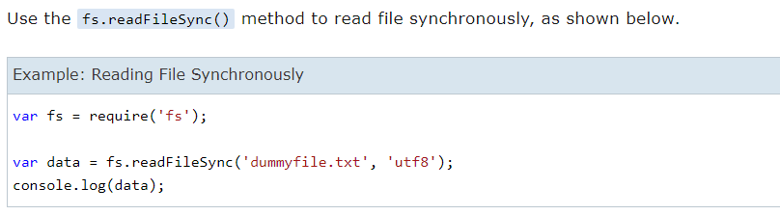
File Systems

Slide 25
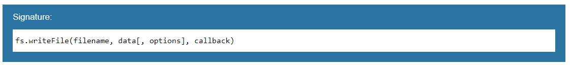
File Systems
Writing a File
Use the fs.writeFile() method to write data to a file. If file already exists then it overwrites the existing content otherwise it creates a new file and writes data into it.
Parameter Description:
filename: Full path and name of the file as a string.
Data: The content to be written in a file.
options: The options parameter can be an object or string which can include encoding, mode and flag. The default encoding is utf8 and default flag is "r".
callback: A function with two parameters err and fd. This will get called when write operation completes.

Slide 26
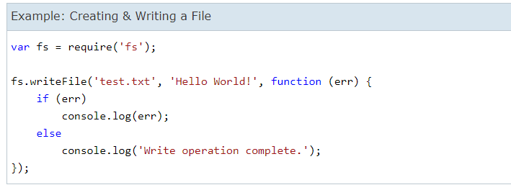
File Systems

Slide 27
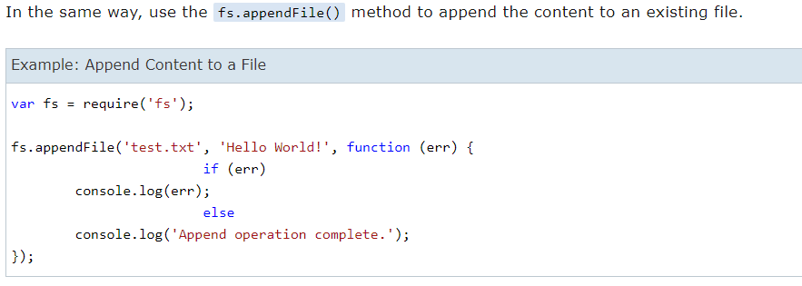
File Systems

Slide 28
Streams
Streams are one of the fundamental concepts of Node.js.
Streams are a type of data-handling methods and are used to read or write input into output sequentially.
Streams are used to handle reading/writing files or exchanging information in an efficient way.
The stream module provides an API for implementing the stream interface. Examples of the stream object in Node.js can be a request to an HTTP server and process.stdout are both stream instances.
Accessing Streams:
const stream = require('stream');

Slide 29
Streams
Advantages of Streams over other data handling methods:
Time Efficient: We don’t have to wait until entire file has been transmitted. We can start processing data as soon as we have it.
Memory Efficient: We don’t have to load huge amount of data in memory before we start processing.

Slide 30
Streams
Types of Streams in Node.js: There are namely four types of streams in Node.js.
Writable: We can write data to these streams. Example: fs.createWriteStream().
Readable: We can read data from these streams. Example: fs.createReadStream().
Duplex: Streams that are both, Writable as well as Readable. Example: net.socket.
Transform: Streams that can modify or transform the data as it is written and read. Example: zlib.createDeflate.

Slide 31
Streams
Implementation of readable Stream:
// Sample JavaScript Code for creating
// a Readable Stream
// Accessing streams
const { Readable } = require('stream');
// Reading the data
const inStream = new Readable({
read() { }
});
// Pushing the data to the stream
inStream.push('GeeksForGeeks : ');
inStream.push(
'A Computer Science portal for Geeks');
// Indicates that no more data is
// left in the stream
inStream.push(null);
// Echoing data to the standard output
inStream.pipe(process.stdout);

Slide 32
Streams
Implementing a Writable Stream: In the outStream, we simply console.log the chunk as a string. We also call the callback function to indicate success without any errors. We will read the data from inStream and echo it to the standard output using process.stdout.
// Sample JavaScript Code for
// Writable Stream
// Accessing Streams
const { Writable } = require('stream');
// Whatever is passed in standard
// input is out streamed here.
const outStream = new Writable({
// The Write function takes three
// arguments
// Chunk is for Buffer
// Encoding is used in case we want
// to configure the stream differently

Slide 33
Streams
// callback is used to indicate
// successful execution
write(chunk, encoding, callback) {
console.log(chunk.toString());
callback();
}
});
// Echo the data to the standard output
process.stdin.pipe(outStream);

Slide 34
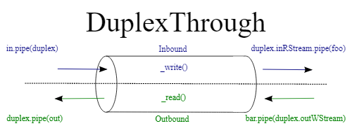
Stream
Duplex streams are a mixture of both the readable and writable streams where both streams are independent of each other.

Slide 35
Stream
import { Duplex,PassThrough } from "stream";
import { createReadStream,createWriteStream } from "fs"
const readStream = createReadStream('data/test.txt');
const writeStream = createWriteStream('data/copy.txt');
class Throttle extends Duplex {
constructor(ms) {
super();
this.delay = ms;
}
_read(){}
_write(chunk, encoding, callback) {
this.push(chunk);
setTimeout(callback, this.delay);
}
_final(){
this.push(null)
}
}

Slide 36

Stream
Transform: Node.js transform streams are streams which read input, process the data manipulating it, and then outputing new data.

Slide 37
Stream
import { Transform } from "stream";
class ReplaceText extends Transform {
constructor(char){
super();
this.replaceChar = char;
}
_transform(chunk, encoding, callback){
const transformChunk = chunk.toString().replace(/[a-z]|[A-Z]|[0-9]/g, this.replaceChar);
this.push(transformChunk);
callback();
}
_flush(callback){
this.push('more stuff us being passed through...')
callback();
}
}
const xStream = new ReplaceText('01');
process.stdin.pipe(xStream).pipe(process.stdout);

Slide 38
Stream
Another application of transform stream is to compressed file or set of files. We need install a library for that “zlib”. The following Code is compressing data
import { createReadStream,createWriteStream } from 'fs';
import zlib from 'zlib';
var gzip = zlib.createGzip();
var rstream = createReadStream('data/test.txt');
var wstream = createWriteStream('data/test.txt.gz');
rstream // reads from myfile.txt
.pipe(gzip) // compresses
.pipe(wstream) // writes to myfile.txt.gz
.on('finish', function () { // finished
console.log('done compressing');
});

Slide 39
Stream
To uncompress we have to use the following code.
import { createReadStream } from "fs";
import zlib from 'zlib';
var gunzip = zlib.createGunzip();
var rstream = createReadStream('data/test.txt.gz');
rstream // reads from myfile.txt.gz
.pipe(gunzip) // uncompresses
.pipe(process.stdout); // writes to stdout

Slide 40
Buffer
The Buffer class in Node.js is used to perform operations on raw binary data.
Generally, Buffer refers to the particular memory location in memory.
Buffer and array have some similarities, but the difference is array can be any type, and it can be resizable.
Buffers only deal with binary data, and it can not be resizable.
Each integer in a buffer represents a byte. console.log() function is used to print the Buffer instance.

Slide 41
Buffer
No | Method | Description
1 | Buffer.alloc(size) | It creates a buffer and allocates size to it.
2 | Buffer.from(initialization) | It initializes the buffer with given data.
3 | Buffer.write(data) | It writes the data on the buffer.
4 | toString() | It read data from the buffer and returned it.
5 | Buffer.isBuffer(object) | It checks whether the object is a buffer or not.
6 | Buffer.length | It returns the length of the buffer.
7 | Buffer.copy(buffer,subsection size) | It copies data from one buffer to another.
8 | Buffer.slice(start, end=buffer.length) | It returns the subsection of data stored in a buffer.
9 | Buffer.concat([buffer,buffer]) | It concatenates two buffers.

Slide 42
Events
Node.js has an event-driven architecture which can perform asynchronous tasks.
Node.js has ‘events’ module which emits named events that can cause corresponding functions or callbacks to be called. Functions(Callbacks) listen or subscribe to a particular event to occur and when that event triggers, all the callbacks subscribed to that event are fired one by one in order to which they were registered.
The EventEmmitter class: All objects that emit events are instances of the EventEmitter class. The event can be emitted or listen to an event with the help of EventEmitter.
Syntax:
const EventEmitter=require('events');
var eventEmitter=new EventEmitter();

Slide 43
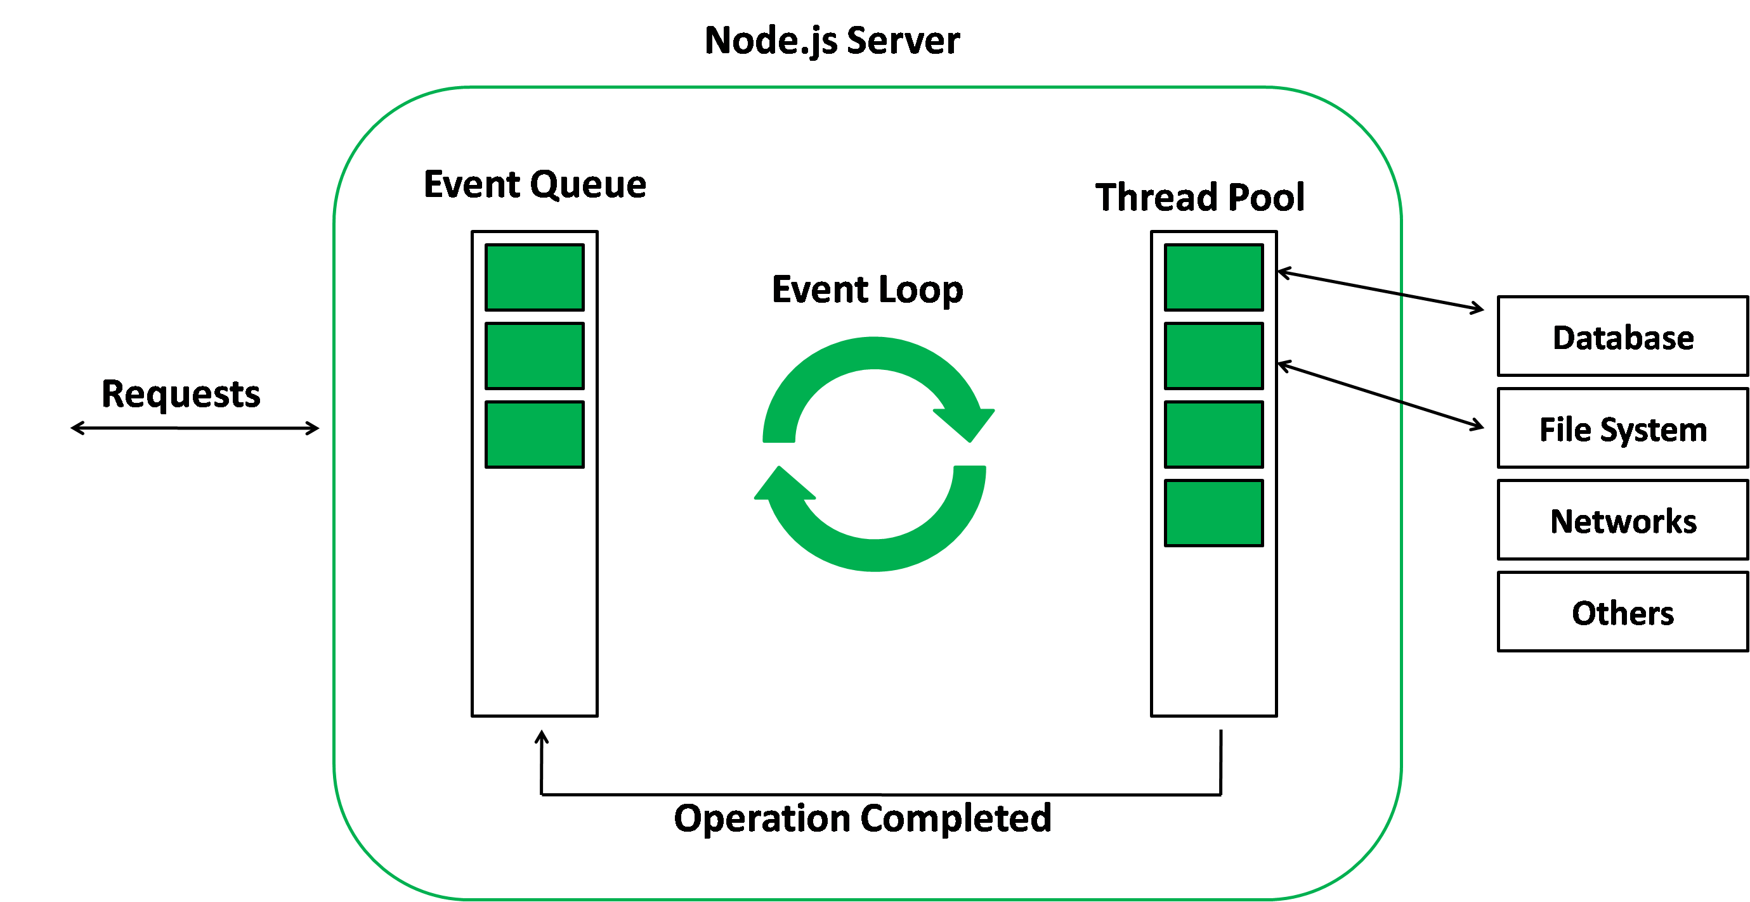
Events

Slide 44
Events
Listening events: Before emits any event, it must register functions(callbacks) to listen to the events.
Syntax:
eventEmitter.addListener(event, listener) eventEmitter.on(event, listener) eventEmitter.once(event, listener)

Slide 45
Event
//Example
// Importing events
const EventEmitter = require('events');
// Initializing event emitter instances
var eventEmitter = new EventEmitter();
// Registering to myEvent
eventEmitter.on('myEvent', (msg) => {
console.log(msg);
});
// Triggering myEvent
eventEmitter.emit('myEvent', "First event");

Slide 46
Node and mongoDb
Node js can act as server for user interfaces.
So, the node can be used to connect to database server, like: mongodb
The module we need to install is : mongodb
It contains a module to connect to databse server.

Slide 47
Node and mongoDb
Simple example to connect to the database
import { MongoClient } from "mongodb";
const url = 'mongodb://127.0.0.1:27017';
const client=new MongoClient(url)
try{
client.connect()
console.log("Database connected..");
}catch(e){
console.log(e)
}

Slide 48
Node and mongoDb
Another example to list database and collections
import { MongoClient } from "mongodb";
async function listDatabases(client){
try{
const databasesList = await client.db("nedb").admin().listDatabases();
console.log("Databases:");
databasesList.databases.forEach(db => console.log(` - ${db.name}`));
}catch(e){
console.log(e)
}
};

Slide 49
Node and mongoDb
async function listCollections(client,DBNAME){
try{
const db2 = client.db(DBNAME)
console.log("Collections:")
db2.listCollections().toArray().then(function(col,err){
col.forEach(el=>console.log(el.name))
})
}catch(e){
console.log("The error is"+e)
}
}

Slide 50
Node and mongoDb
// server location
const url = 'mongodb://127.0.0.1:27017';
const client=new MongoClient(url)
try{
await client.connect();
await listDatabases(client);
await listCollections(client,"nedb");
//setTimeout(()=>console.log("Waiting to close..."),10000);
console.log("Got connection");
}catch(e){
console.log(e)
}finally{
setTimeout(()=>client.close(),10)
}

Slide 51
Node and mongoDb
Insertion of Data into mongodb
import { MongoClient } from "mongodb";
const url = 'mongodb://127.0.0.1:27017';
const client=new MongoClient(url)
async function insertData(client,DBNAME,data){
const db = client.db("newdb");
const collection=db.collection("mycoll")
collection.insertOne(data)
}

Slide 52
Node and mongoDb
try{
await client.connect();
await insertData(client,"newdb",{_id:1001,name:"Sam",age:39})
console.log("Got connection");
}catch(e){
console.log(e)
}finally{
setTimeout(()=>client.close(),10)
}

Slide 53
Node and mongoDb
Update data in mongodb
import { MongoClient } from "mongodb";
const url = 'mongodb://127.0.0.1:27017';
const client=new MongoClient(url)
async function updateData(client,DBNAME,COLLECTION,query,newval){
const db = client.db(DBNAME);
const collection=db.collection(COLLECTION)
collection.updateOne(query,newval)
}

Slide 54
Node and mongoDb
try{
await client.connect();
await updateData(client,"newdb","mycoll",{_id:3},{$set:{sal:20000}})
console.log("Got connection");
}catch(e){
console.log(e)
}finally{
setTimeout(()=>client.close(),10)
}

Slide 55
Node and mongoDb
Delete data in mongodb
import { MongoClient } from "mongodb";
const url = 'mongodb://127.0.0.1:27017';
const client=new MongoClient(url)
async function deleteData(client,DBNAME,data){
const db = client.db("newdb");
const collection=db.collection("mycoll")
collection.deleteOne(data)
}

Slide 56
Node and mongoDb
try{
await client.connect();
await deleteData(client,"newdb",{_id:1001})
console.log("Got connection");
}catch(e){
console.log(e)
}finally{
setTimeout(()=>client.close(),10)
}

Slide 57
Node and mongoDb
Mongoose:
Mongoose is an Object Data Modeling (ODM) library for MongoDB and Node.js.
It manages relationships between data, provides schema validation, and is used to translate between objects in code and the representation of those objects in MongoDB.

Slide 58
Node and mongoDb
Example for data access using mongoose
import mongoose from "mongoose";
const url = 'mongodb://127.0.0.1:27017/nedb';
try{
mongoose.connect(url);
console.log("Connected successfully")
const userSchema = {
_id:Number,
email: String,
password: String,
};

Slide 59
Node and mongoDb
const User = new mongoose.model("User", userSchema);
const user = new User({
_id:1,
email: "abc@example.com",
password: "1215465",
});
//user.save()
//user.updateOne({_id:1},{password:"46498798"})
//user.deleteOne({_id:1})
console.log("Data saved")
}catch(e){
console.log(e)
}finally{
console.log("Finally here")
}

Slide 60
Multi-processing
A Node.js application runs on a single thread. In this thread an event loop listens for events and then triggers the events associated callback function upon detection. By this simple illustration we can already see that Node.js does not support multithreading because each application is run on a single thread.
Although multithreading is not supported there is a way to harness the power of a multicore system by using processes. Node.js has a module called cluster designed to support a multiprocessing alternative. Let’s view some code from the Node.js docs.

Slide 61
Multi-processing
const cluster = require('cluster');
const http = require('http');
const numCPUs = require('os').cpus().length;
if (cluster.isMaster) {
// Fork workers.
for (var i = 0; i < numCPUs; i++) {
cluster.fork();
}
cluster.on('exit', (worker, code, signal) => {
console.log(`worker ${worker.process.pid} died`);
});
}
else {
// Workers can share any TCP connection
// In this case it is an HTTP server
http.createServer((req, res) => {
res.writeHead(200);
res.end('hello world\n');
}).listen(8000);
}

Slide 62
HTTP Server
The http server can be created using node js, but we have to install http library using npm tool.
The following is a basic http server code:
var http = require("http");
var server = http.createServer(function(request, response) {
response.write("Hello <strong>HTTP</strong>!");
response.end();
});
server.listen(8000);

Slide 63
In the given example, http module’s createServer() method is used to create a new instance of an HTTP server.
Much like the equivalent TCP method of the same name, the server returned by createServer() is an event emitter, and is not bound to any specific port.
On the last line, the server is bound to port 8000 using the listen() method.
The http version of listen() is also used in the same fashion as the TCP listen() method.

